Slide 1
introduction for access control

Slide 2
Access management
Identification : username, access card, biometrics (something you know, you have, you are)
Authentication :
password authentication protocols, CHAP(Challenge Handshake Authentication Protocol)
SSO(CAS)
RADIUS(Remote Access Dial In User Service, usually client is an application server), TACACS(Terminal Access Controller Access Control System), XTACACS, TACACS+
LDAP(Lightweight Directory Access Protocol)
Certificate-based authentication, Kerberos(Ticket-based authentication), SAML(Security Assertion Markup Language), IDaaS(Identity as a service), Oauth and OpenID
Multi-factor authentication
Authorization :
Least privilege
Separation of Duties
Role-based access control, Implict Deny Principle, Time Of Day restriction

Slide 3
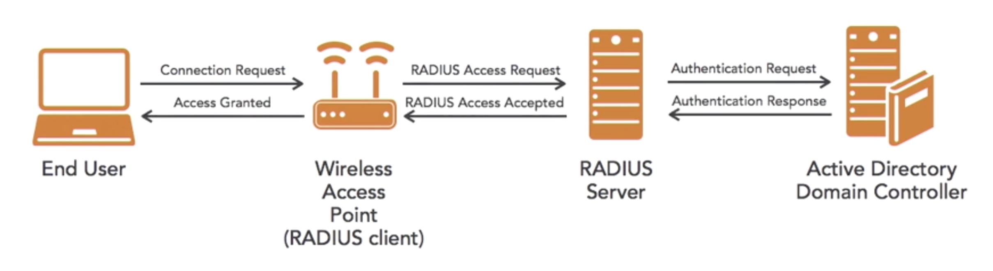
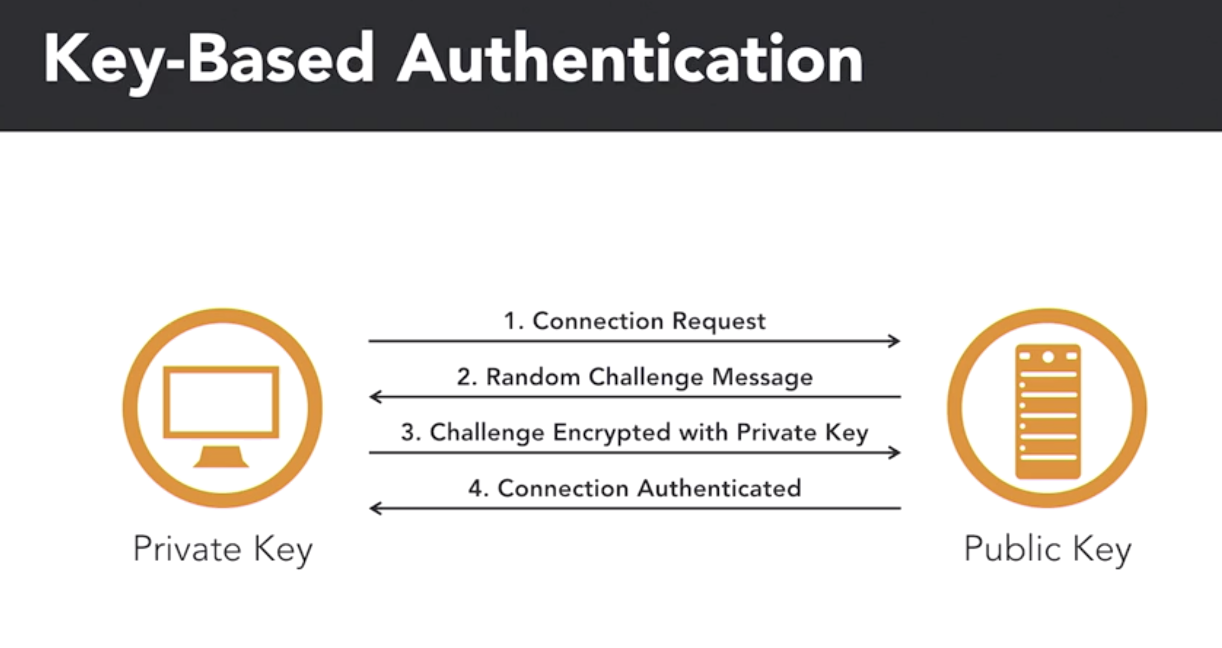

Slide 4
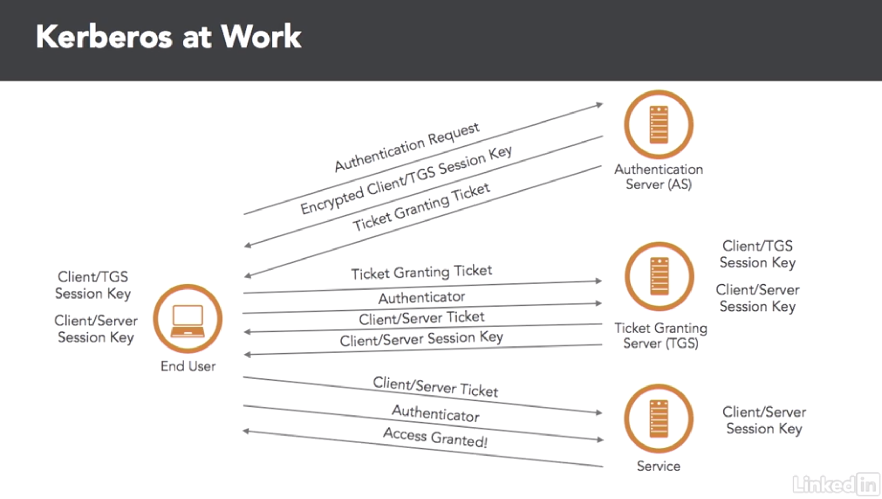
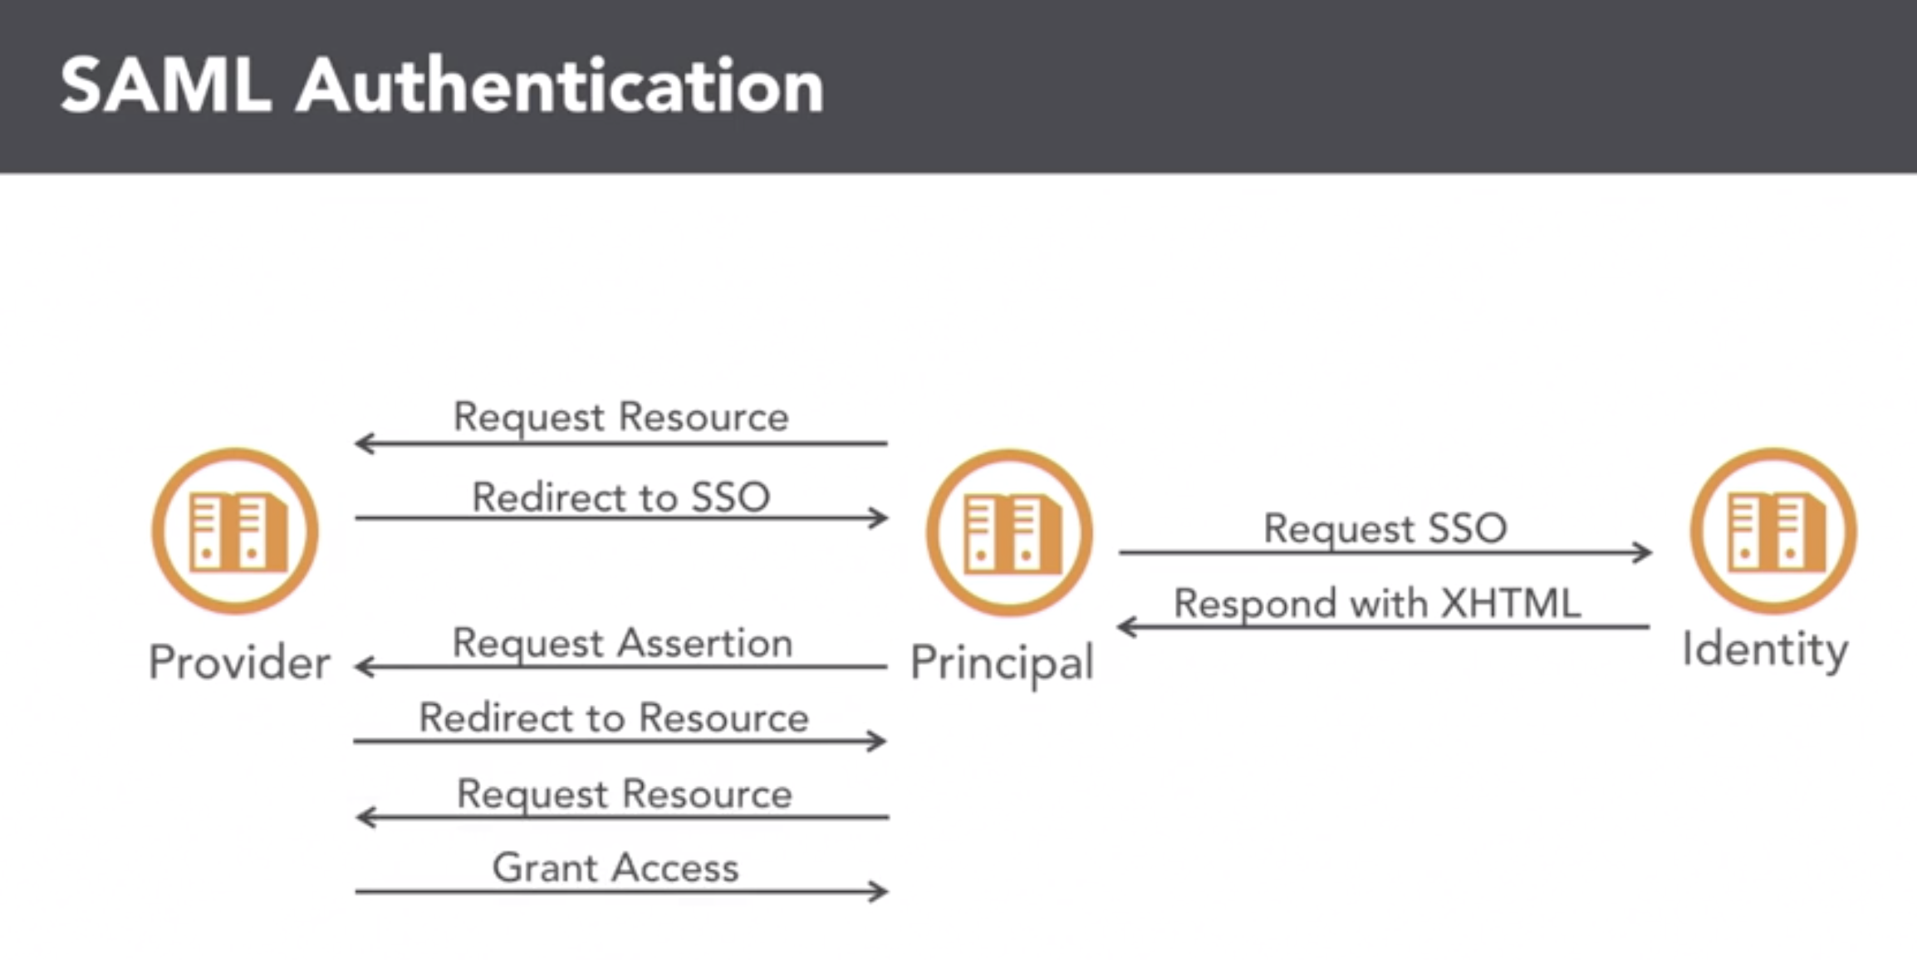

Slide 5
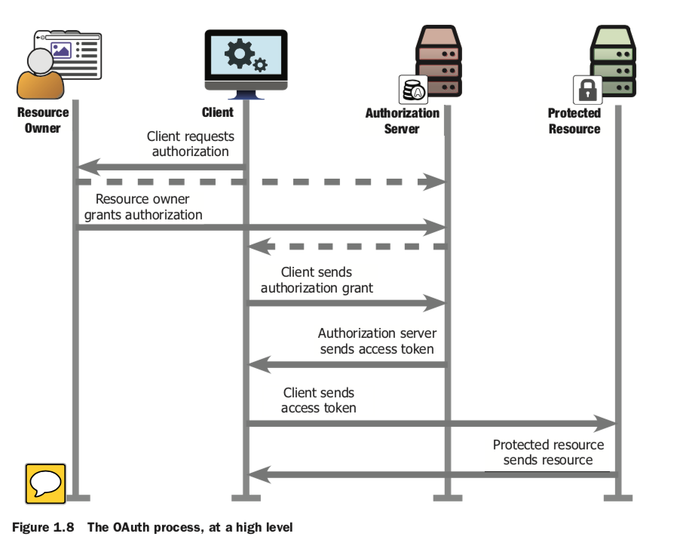
Oauth2.0
Roles
OAuth defines four roles:
resource owner
resource server
client
authorization server
Authorization Grant Type:
Authorization code
Implicit
Resource owner password credentials
Client credentials

Slide 6
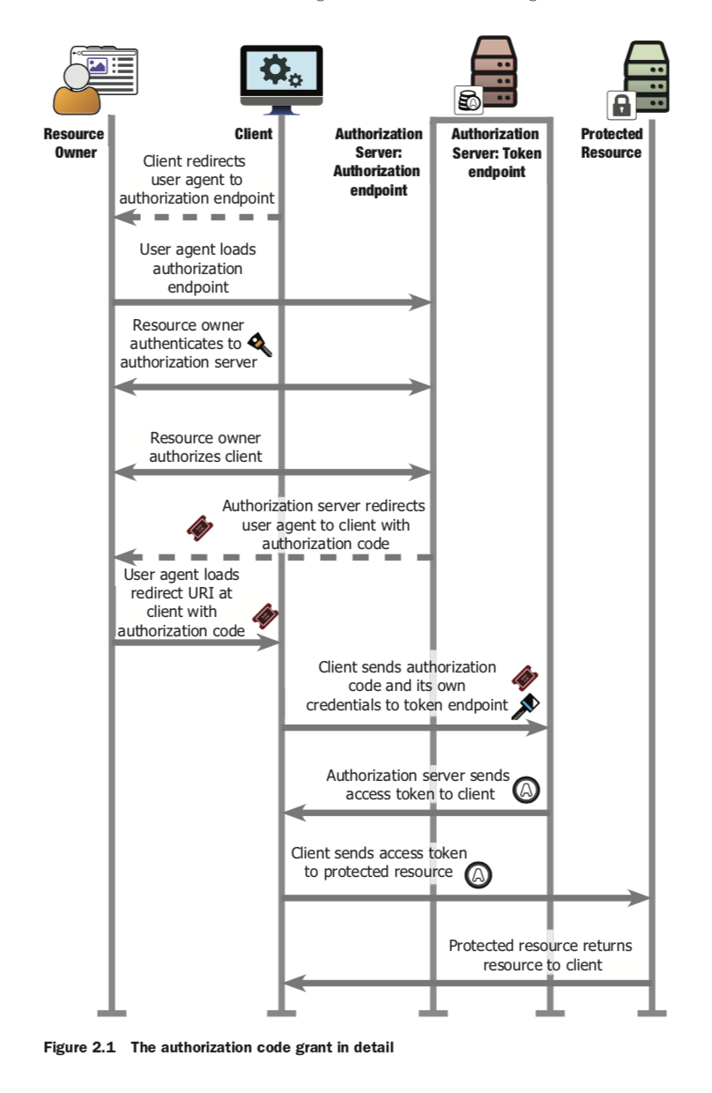

Slide 7
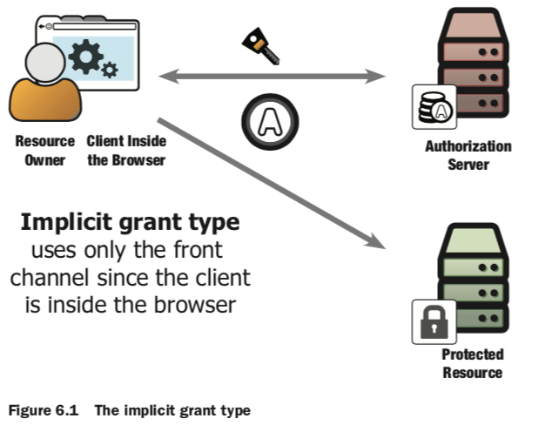
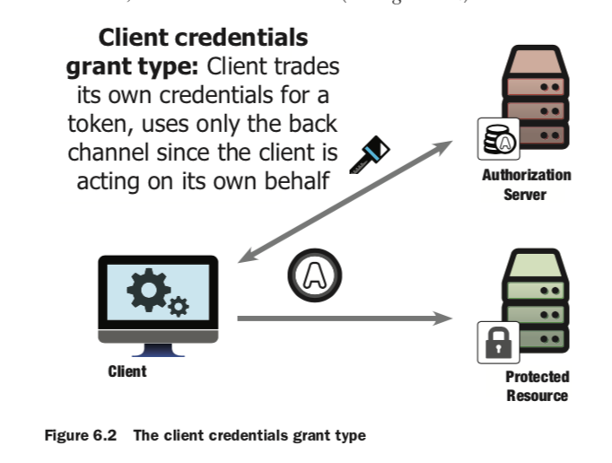
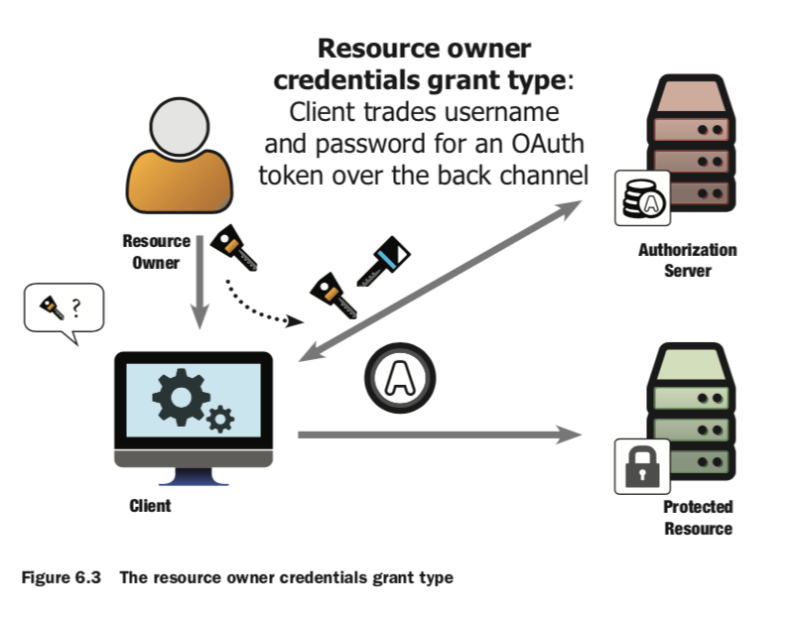

Slide 8
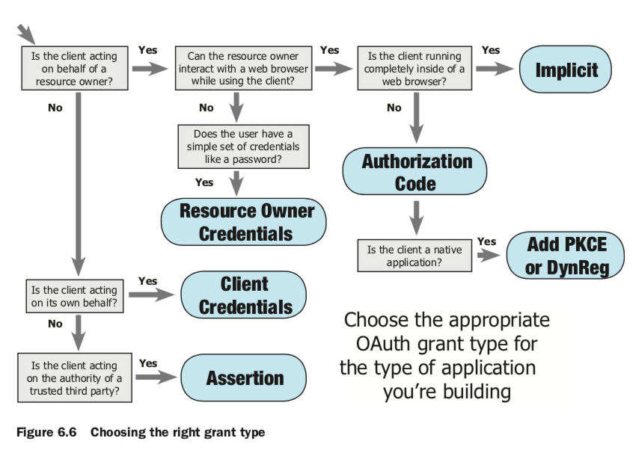

Slide 9
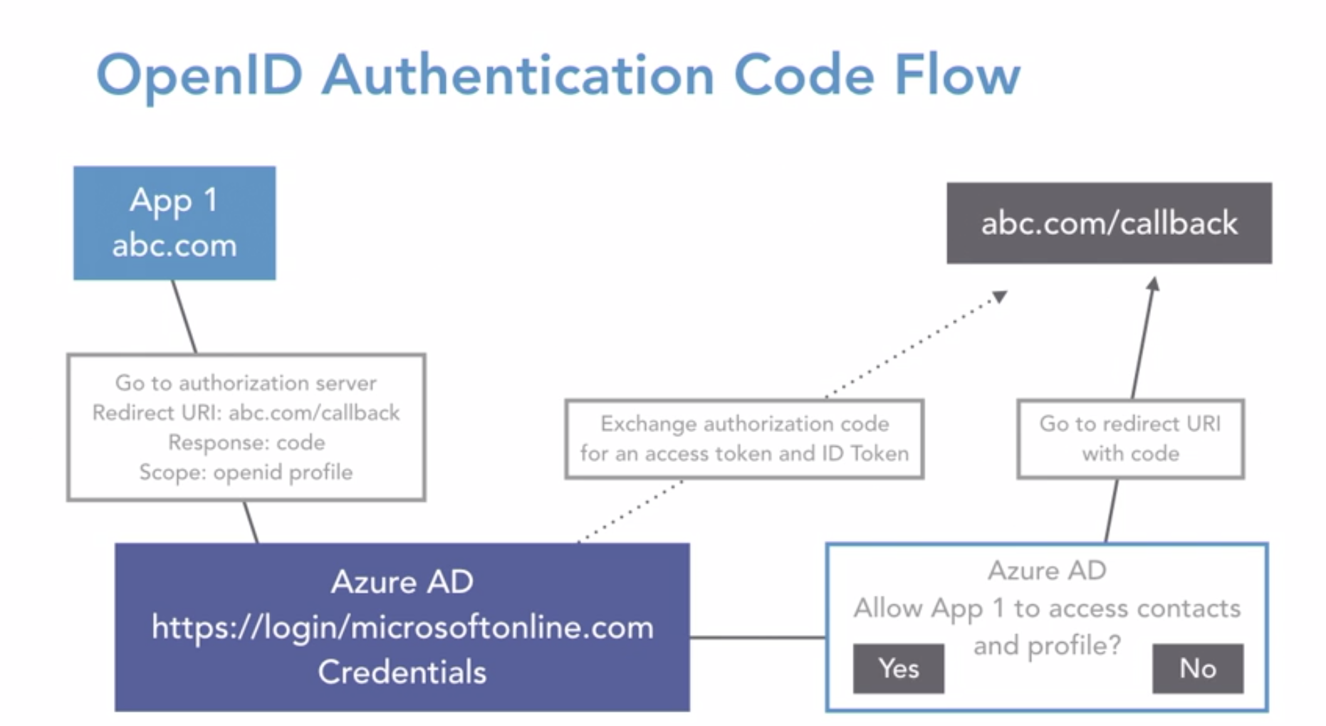
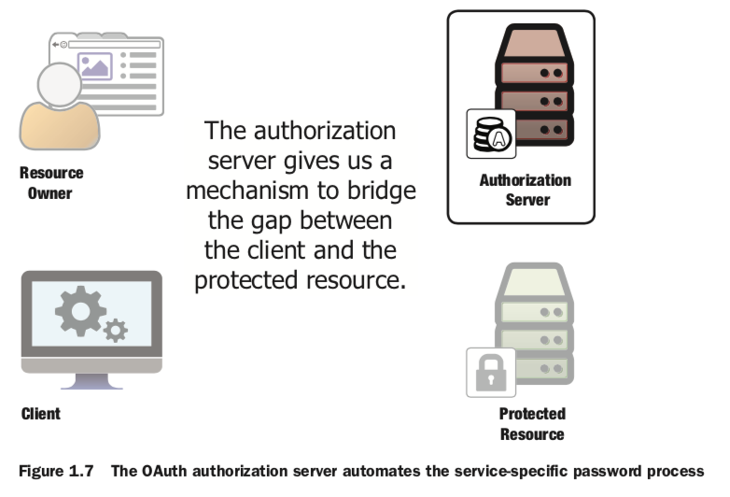

Slide 10

reference
https://tools.ietf.org/html/rfc6749
https://www.linkedin.com/learning/cissp-cert-prep-5-identity-and-access-management-2/advanced-authorization-concepts?u=26131626

